Slide 1

DATA Capstone!

Slide 2
Timeline
Progress report
Presentation
Progress report
Dry run
Proposal
Mon 4/24 | Tue 4/25 | Wed 4/26 | Thu 4/26 | Fri 4/27 | Mon 5/1 | Tue 5/2 | Wed 5/3 | Thu 5/4 | Fri 5/5 | Mon 5/8 | Tue 5/9 | Wed 5/10 | Thu 5/11
Data Gathering
Proposal
Data Cleaning
Graduation!
Monica’s BD!
Exploratory Data Analysis
Data Story
Draft
Practice
Final Draft
Present

Slide 3




Capstone
Give
Plan
Use
Discuss
Give a 10-minute presentation on your an independent data study
Presentations will be in Zoom and will be recorded
Audience will be your fellow students, staff, and external guests
Plan to present a draft version before your final presentation
Use Powerpoint or Google Slides
Be cautious about presenting in Tableau due to crash/freeze problems
Discuss (briefly) the tools you used and your data analysis process

Slide 4
Data Gathering
Choose your dataset(s)
Limit your failure modes
Find a combination of time, (discrete) dimensions, and (continuous) measures
We can assign a dataset to you if you’d like
You can revisit a dataset you’ve already looked at with a new angle
You should not change your dataset choice after week 1
A very large dataset will slow your analysis and cripple your computer
Don’t try to join 5 data sets from different sources.
Start small and simple to avoid the weight of analysis paralysis.
If you work in Tableau, save often!
This is not a PhD thesis, it’s a short presentation

Slide 5
Find the Intersection
You’re interested in the topic
Data is available
Capstone
You would show this to potential employers

Slide 6
Proposal
Project topic - identify the topic of your project and why you chose it.
Business objective - identify what problem you are trying to solve or the objective you want to support.
Intended audience - identify who will benefit from this proposal and how they can make decisions based on your analysis.
Previous research or current knowledge - identify whether you have worked on previous analysis or have current knowledge of your topic.
Data sources - identify the datasets you plan to use
Questions – identify research questions that you hope to answer
Expected outcome - identify what you think the outcome of the analysis will be.

Slide 7

Data Wrangling
Use Excel or Python or DataBrew for data cleaning
Remove duplicates
Find and replace troublesome characters including spaces, NULL, or NA
Normalize data
Validate data
Change case (upper/lower)
Make sure numbers are numeric types if you’re going to perform math
Use SQL to reduce complex relational data
Don’t rush to get to Tableau

Slide 8
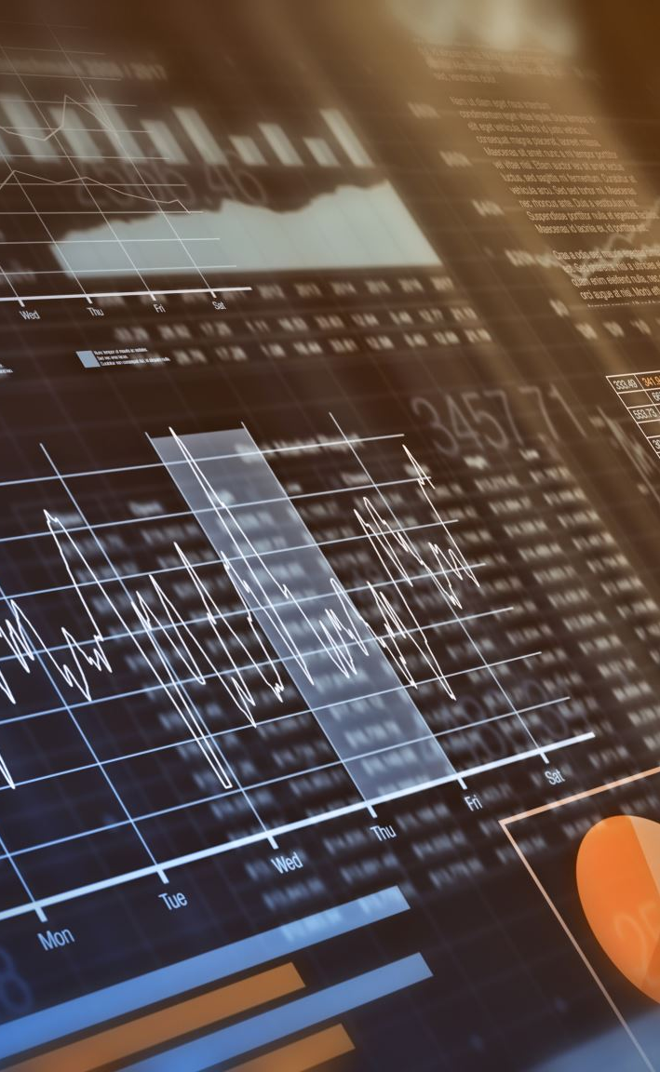
Exploratory Data Analysis
Find out what the data is saying – do not look for data that says what you want to say
At this point use visualizations to understand (not to impress)
Generate descriptive statistics, understand what they mean
You do not need to use all your visualizations in your final presentation
Ask and answer questions!
How is the data distributed (symmetric or asymmetric)?
Is X related to Y ?
Does Y change over time?
How do X and Y influence Z?
Is there any obvious variation in the data (night/day, weekday,weekend, season)?

Slide 9
Your Story
Structure
Remember the narrative structures we discussed
Find
Look for setting, characters, conflict
Outline
Outline your story, then find visualizations that support it
Don’t Fixate
Don’t get fixated. “The world’s greatest dashboard” is not a story. Instead, think of the dashboard as a storytelling device.
Surprise
Look for surprising elements. Highlight them.
Tell
Be conversational. Bring your audience into your story.
Hook
Find a ‘hook’

Slide 10
Draft
Outline your talk
Create one slide per talking point
Determine which visuals are in and which are out
Draft first, polish later
Perfect is the enemy of good enough
Practice with colleagues, mentors, instructors
Watch out for digressions
Figure out what you are going to say for each slide
Toss out slides that don’t add to the message

Slide 11
Present
Do
Tell a story
Explain your analysis
Draw attention to your points. Highlight and annotate.
Show how you answered questions
Keep it to 10 minutes
Don’t
Read your presentation
Focus on decorations over content
Expect that the audience will see what you see in your charts
Describe your visuals (e.g. “This is a bar chart. This is a scatter plot…”)

Slide 12
Common Capstone Failure Modes
Too much
Content (e.g. 25 slides for 10 minute talk) in your presentation
Digressions into minutia
Busy charts
Technical jargon
Scope too large (e.g. dashboard + machine learning + optimization
Not enough
Context in your presentation. Why do we care?
Content (e.g. 4 slides, any questions?)
Inflection in your delivery (beware of monotone…)
Early visualizations to understand your data

Slide 13
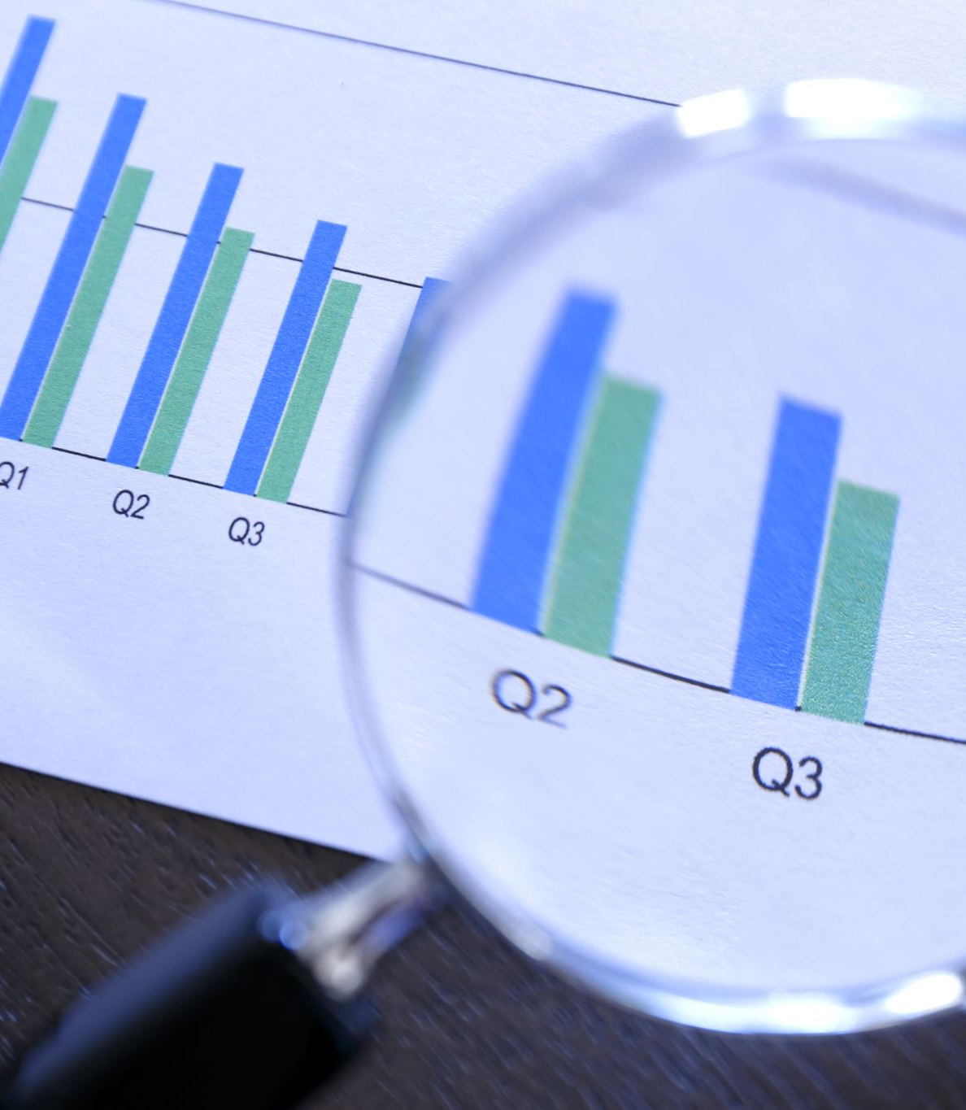
Data Selection
Good data
A good data set has a mix of dimensions, measures, and time-series
A good data set has well defined units
A good data set doesn’t have large gaps
Choose data that demonstrates your enthusiasm for a topic to prospective employers
Is public so others can see it
Poor data
Too many dimensions, not enough measures
Too many measures, not enough dimensions
Narrow survey results
Biased data (not representative)

Slide 14
Data Sources
Other
Kaggle
data.world
AirBnB
Zillow
Pew research center
https://finance.yahoo.com/
Our world in data (OWID)
International
Other
United Nations
World Bank
CIA World Factbook
Data.gov
https://aws.amazon.com/opendata/
https://healthdata.gov
https://datasetsearch.research.google.com
https://www.bls.gov/data/
https://data.cms.gov
https://dataverse.harvard.edu/
https://collegescorecard.ed.gov/data/
https://www.ncei.noaa.gov/weather-climate-links
Open data (government)
https://opendata.cityofnewyork.us/
https://data.cityofchicago.org/
https://live-durhamnc.opendata.arcgis.com/
https://data.seattle.gov/
https://data.europa.eu/en
https://data.london.gov.uk/dataset
https://opendata.tel-aviv.gov.il/en/Pages/home.aspx
https://africaopendata.org/
https://data.gov.sg/

Slide 15
Week 1 Groups
Monica
Vadim
Dennis
Victor Mantilla Colon
Rosana Infante
Chhaya Penn
Kosta Louvros
Brenda Jerez
Ess Guernah
Marcus Madison
Angelica Vera
Rosemary Espinal
Aaron Potts
Chrissy Taylor
Timothy Yip
Marianna Beaute
Daphney Oliveira
Shaday Brown
Kristian McCombs
Adam Shabana
Ali Ashfaq
Sol-Marie Quintero
Chad Crossman
Virna Brown
Diana Ospina

